Slide 1


Mark Kipchumba
ESCROWX - A CONDITIONAL PAYMENT PLATFORM FOR KENYA'S DIGITAL COMMERCE ECOSYSTEM
Eclectics International Limited

Slide 2
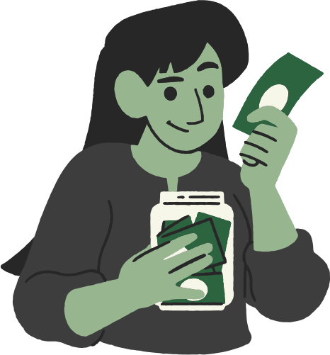
Problem Statement
Millions of transactions happen daily on WhatsApp, Instagram, TikTok, and Jiji yet behind every one of those transactions is a buyer sending money to a stranger, with no contract, no guarantee, and no recourse if things go wrong. Sellers disappear after payment. Goods arrive damaged or not at all. Services are paid for and never delivered. When something goes wrong, there is no system to turn to no dispute process, no refund mechanism, and no authority to hold either party accountable.

Slide 3

The M-Pesa Gap
You Can't Out-Earn Your Way Out of Bad Habits
M-Pesa is fast, reliable, and widely accessible
But payments are instant and irreversible
No hold function. No conditional release. No recourse.
Once money leaves a buyer's account — it is gone

Slide 4

The Solution
EscrowX is not a bank, a wallet, or a payment processor. It is a conditional payment intermediary — adding a trust layer on top of M-Pesa so buyers and sellers can transact with confidence
Buyer pays → EscrowX holds → Seller delivers → Funds released

Slide 5
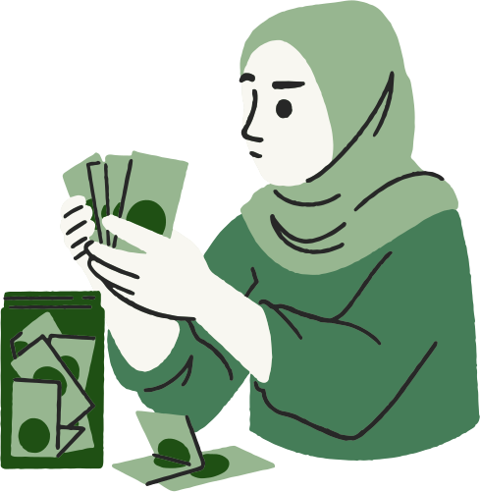
How It Works
Buyer initiates transaction and funds escrow
Seller delivers product or service
Buyer confirms receipt
Funds are released to seller
If disputed — admin mediates and resolves

Slide 6
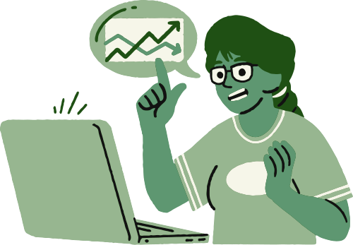
Who It's For
Instagram, TikTok and WhatsApp sellers transacting with unknown buyers
Freelancers — designers, developers, content creators
Jiji traders dealing in high-value second-hand goods
SMEs conducting remote transactions without formal contracts

Slide 7

System Architecture
Layer | Technology
Frontend | Flutter
Backend | Spring Booot (Java)
Database | Postgre SQL
Payment | Mpesa Daraja API

Slide 8
Thynk Unlimited
THANKYOU
Financial Freedom is a Choice

